Slide 1
Equity Derivatives Gamma Exposure Model
Fundamental Investments
November 2023

Slide 2
Table of Contents
Understanding Gamma Exposure
Gamma Exposure Model and Profile
Total Gamma Exposure
Gamma by Calls and Puts
Gamma Profile with Flip Points
Looking Ahead
Pitfalls of Black-Scholes
Stochastic Volatility Modeling

Slide 3
Understanding Gamma Exposure
Color Palette, use eye dropper, for coloring
Allows us to track dealer and total gamma exposure in all listed $SPX options by visualizing the data by strike
Gamma as a Second Order Derivative
Market Maker Delta Hedging
What is Gamma?
Gamma is a second order derivative that represents the rate of change in an option’s delta per one point move in the underlying asset
SPX Options comprise roughly 20% of the SPX market cap
Understanding Gamma exposure is critical to dealers as they hedge the delta risk from the billions of dollars of notional value from client orderflow, each day
Two Ways to Delta Hedge an Options Portfolio
Offset Delta Risk by Buying/Selling Underlying Asset
For example, assume you are long calls with a net delta position of 0.5. The options trader would need to sell 50 shares of the underlying asset to become delta neutral
Offset Delta Risk by Buying/Selling Futures Contract
Provides a much cheaper alternative to hedging while minimizing the market impact. This remains the primary method for market makers
OPEX and Triple Witching Events
Dealer Derivatives Feedback Loop
Each month, dealers undergo a unanimous procedure known as OPEX which is marked by the month’s expiring options. Dealers need to decide how to alter these positions and their respective hedges. As market makers must achieve a risk-neutral options portfolio, this is historically an incredibly choppy market event
Triple Witching occurs once each quarter, overlapping with the month’s OPEX. However, triple witching includes equity options, index options as well as futures contracts. Dealers must decide whether to roll over or liquidate their E-Mini contracts in addition to the options they hold.
Understanding where the Gamma exposure is highest tells us where dealers will hedge
Summarizing Sell-Side Options Market Making & Hedging
Sell-Side firms are issuing options worth billions in notional value each day. To maintain a balanced book, they hedge any residual exposure with shares or futures. As the underlying moves, so does the delta-hedging requirement and thus are forced to trade the underlying to achieve delta-neutrality.
The loop occurs where the type and amount of options that investors trade influences the underlying price action. If dealers are primarily selling calls, they are going into the market to buy the underlying or the respective amount of futures contracts.
Notes:
Remember to speak in segmented or numbered format. 1) 2) 3) reasons etc.

Slide 4
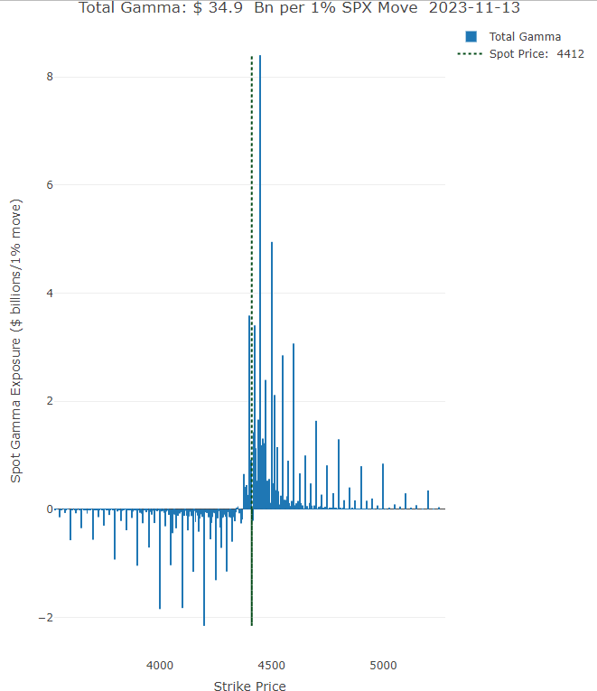
Gamma Exposure Model - Total Exposure per 1% Ch in Price
Visualizing Market Gamma Exposure
Graph shows total gamma in Bn per 1% of move
Visualizes how much gamma is outstanding at each strike
Each bar represents how much delta needs to be bought or sold if the market moves 1% from spot
Chart shows call walls and put walls
Ex. 4450 is a call wall
Levels where there is large call or put gamma
Understanding Call and Put Walls
Establishes rudimentary probabilistic trading range
Assumption suggests that MM is long calls and short underlying
As underlying increases, delta needs to be hedged and MM sells
Results in price hovering around the call wall as dealers hedge, suppressing volatility
Put holders generally open OTM, when puts hit the money they roll down the contracts in mass
This is because put reward/risk curve is not as steep ATM/ITM
Immediate effect of closing these positions ATM prompts dealer buying
Causes lower imp vol → shrink deltas → more MM buying
Calculating Gamma
Finds total Gamma exposure from 80/120 of spot
Adjustable range in code
Calculates gamma exposure by strike

Slide 5
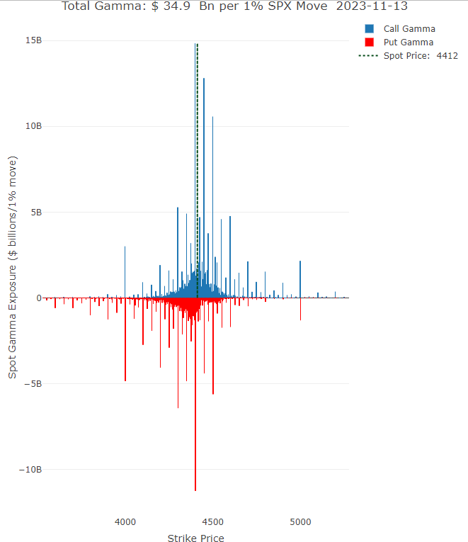
Gamma Exposure Model - Total Exposure by Calls and Puts
Visualizing Market Gamma By Calls & Puts
Graph shows gamma exposure by strike in terms of calls and puts
Reminder → Long call/Short put produces positive gamma while Short call/Long put produces negative gamma
In addition to all things from the previous slide being true, this tells us:
Executed SM positions by strike
Market directionality by positioning in calls & puts
Institutional Order Flow
Most institutions are buying point to point call spreads at 98/102 of strike
Model visualizes where positions are being executed
Can be loosely interpreted to understand the liquidity distribution in calls and puts
If we can visualize where people are trading, and what positions they are trading, we can position ourselves accordingly to follow the liquidity
Calculating Gamma
Finds total Gamma exposure from 80/120 of spot
Adjustable range in code
Calculates gamma exposure by strike

Slide 6
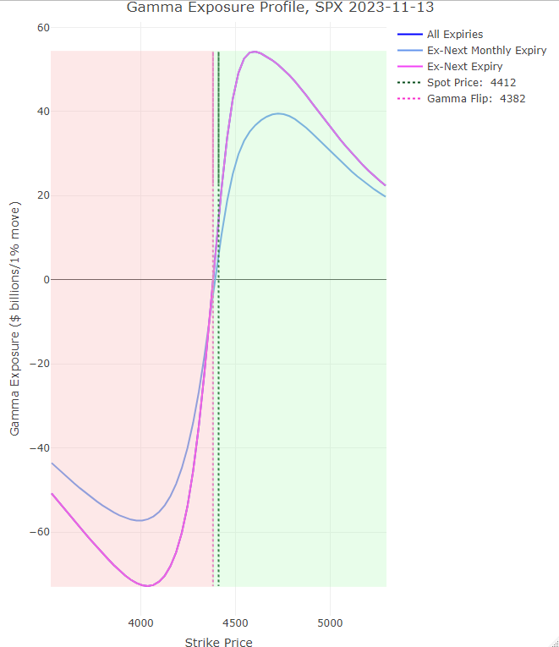
Gamma Exposure Model - Gamma Exposure Profile & Flip Point
Gamma Exposure Profile Explained
Estimate of gamma over a range of spot prices
Gives an approximation of the amount of dealer hedging flows across spot levels
Short gamma to the left
Long gamma to the right
Gamma flip point is the zero gamma point
Indicates where dealer gamma exposure flips positive or negative
Seeks to model how gamma changes when the price of the underlying changes
Calculating Gamma
Model Specifications and Flexibility
Finds total Gamma exposure from 80/120 of spot
Adjustable range in code
Calculates gamma exposure by strike
Currently the model is only considering gamma sample size for 80/120 of spot. This can be widened or narrowed in the code, easily.
Gamma Exposure Profile is calculated off the 60 most relevant strikes (30 above spot 30 below spot) and can be widened or narrowed easily
Model calculates these based off of CBOE options data
Can be applied to any single stock, index, or ETF with a liquid options chain
Serves as synergistic model to assist all divisions in executing trades and understanding exposure and risk levels

Slide 7
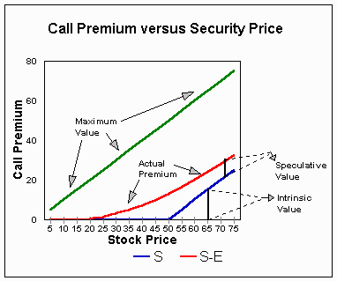
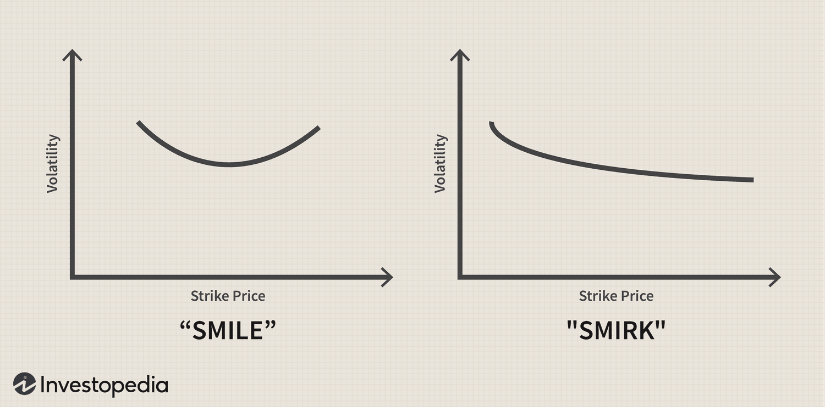
Problems With the Black-Scholes Model
One of the most popular but outdated models which uses partial differential equations to price options
Uses five input variables- the strike price of an option, the current stock price, the time to expiration, the risk-free rate, and the volatility.
Limitations of Black Scholes Model:
Assumes Constant Volatility- Assumes volatility remains constant over the option’s life. However, volatility fluctuates with the level of supply and demand.
Other Assumptions- No transaction cost or taxes, and risk-free interest rate is constant for all maturities, and all these assumptions can lead to prices that deviate from actual results.
Only used to price European options, and does not take American options into account where options can be exercised at any point before expiration
Notes:
smile is based on skew (yield curve of an option). Structured based on option skew not interest rate.

Slide 8
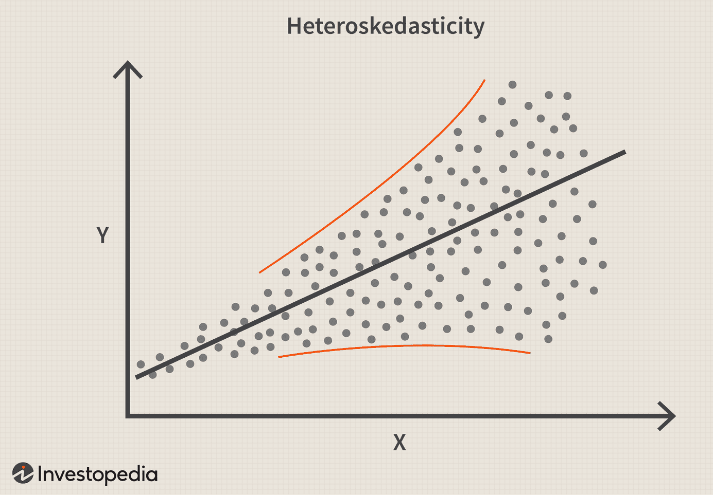
How a GARCH Model Addresses These Issues
The Generalized Autoregressive Conditional Heteroskedasticity (GARCH) model is used for modeling volatility in financial time series.
GARCH Model forecasts the volatility of financial returns over time. It explicitly allows volatility to vary over time and capture volatility clustering, where periods of high volatility tend to be followed by additional periods of high volatility. The model also includes an autoregressive component for capturing past volatility and a conditional heteroskedasticity component that models the variability of the series conditional on past observations.
In practice, the estimated volatility from a GARCH model can be used as an input in option pricing models to account for changing volatility conditions.
Explicit Issues Addressed:
Volatility Clustering: Financial time series often exhibit periods of high volatility followed by periods of low volatility. GARCH models are well-suited to capture this clustering of volatility.
Time-Varying Volatility: GARCH models allow for the estimation of time-varying volatility, addressing the limitation of assuming constant volatility in the Black-Scholes model.
Notes:
The Black-Scholes Model assumes constant volatility over the option's life, which means it doesn't capture the volatility clustering observed in financial time series.
While the Black-Scholes model assumes constant volatility, the GARCH model allows for time-varying volatility, making it more suitable for capturing the dynamics of financial markets where volatility changes over time.

Slide 9
Q&A

